Slide 1
DevOps Tools Training at Dell EMC
Project Guide,
Prof, B.S. HARISH
Mentor,
Gourishankar Mohapatra,
Manager, Software Engineer,
Dell EMC, Bagmane Tech Park,
Bengaluru.
Presented by,
KISHORE G R
(01JST19PDS005)

Slide 2
Contents
About The Company
About The Team
Tools and Languages trained
Project Taken-up
Conclusion
My Contributions

Slide 3



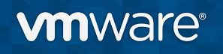



About The Company
EMC was acquired by Dell in 2016.
It is a Product based company.
Mainly focuses on Data Storage, information security, virtualization, cloud computing and other products and services that enables organizations to store, manage protect and analyze data.

Slide 4
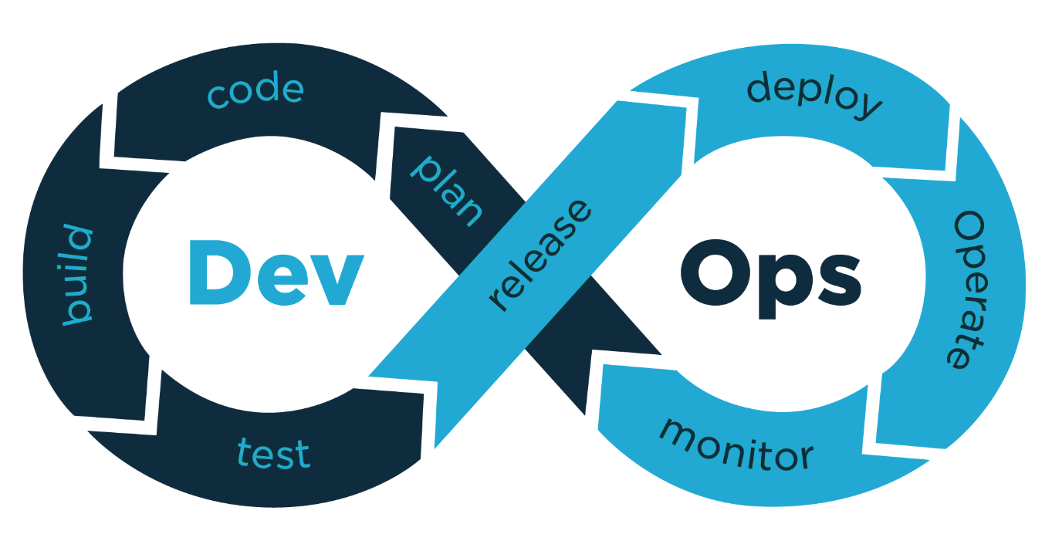
About the Team
DevOps Organisation
DevOps: A set of practices that combines software development (Dev) and IT operations (Ops).
Several DevOps aspects came from Agile methodology.

Slide 5
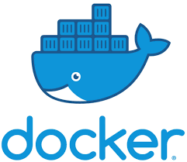



Tools Trained
Docker is a containerization tool that helps in isolating a process from rest of the processes that are running in a system, where it bundles application code, support binaries and configuration together.
Kubernetes is a container orchestration tool, that is; it helps in automating deployment, scaling and management of containerized application.
Jenkins is an open source automation server-based system, which helps in accelerating software development process by facilitating continuous integration and continuous delivery.
Jfrog is an artifacts management tool; it helps in maintaining the build artifact and dependencies from development to production in a universal artifact repository

Slide 6
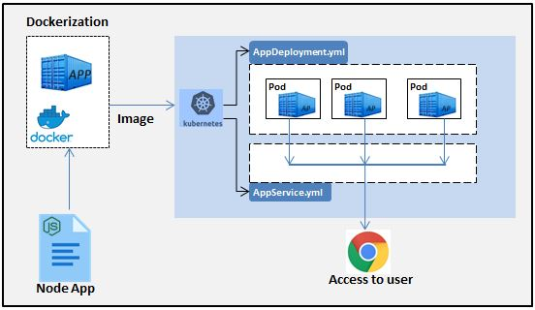
Assignments Taken-up
Deployment of NodeJS application using Kubernetes and to perform Liveness Probe on it

Slide 7
Perform readiness probe on Kubernetes pod deployment.
Upload, download and search artifacts with and without properties using AQL query.
Create a Python script that takes a text file (containing the artifacts path) as input and downloads all the mentioned artifacts.
MY CONTRIBUTION:
I have uploaded my work on AQL query on a companies confluence page.
Any Dell EMC employee across the globe wanting to work on AQL can refer my page for guidance.

Slide 8
Conclusion
Firstly, the industrial training has helped me in realizing the gap between the technical knowledge possessed by a student and a professional software engineer.
The internship has helped me in understanding,
. How an organization works, and how the roles are divided.
. How team members work together to meet the goal.
. How knowledge sharing takes place in organisations.
. How plans and strategies are discussed during meetings.
. How one should follow companies code of conduct to maintain a productive ambience in the organisation.

Slide 9
THANK YOU

Slide 11
DEMO

Slide 12
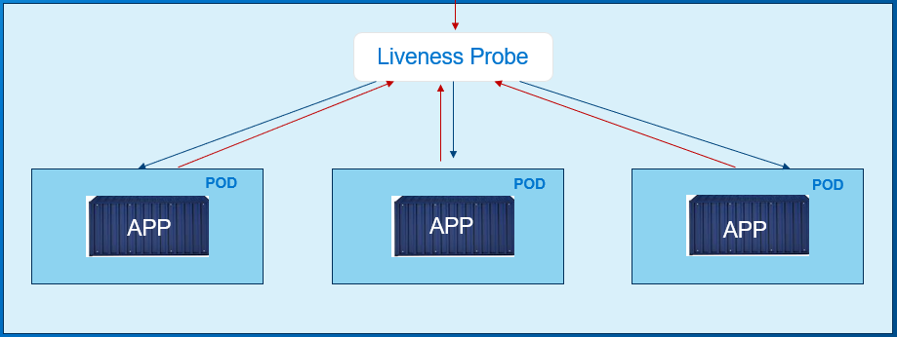
LIVENESS PROBE

Slide 13
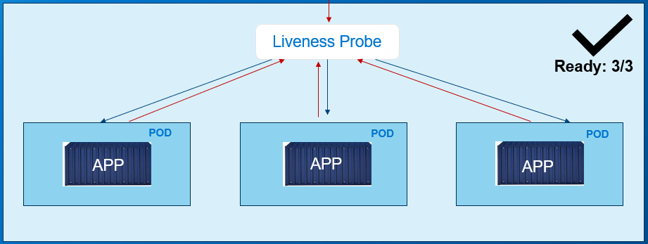
LIVENESS PROBE

Slide 14
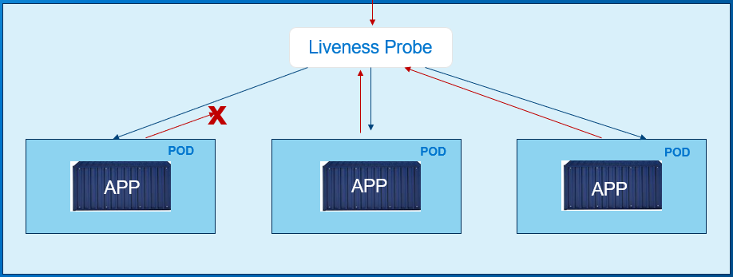
LIVENESS PROBE

Slide 15
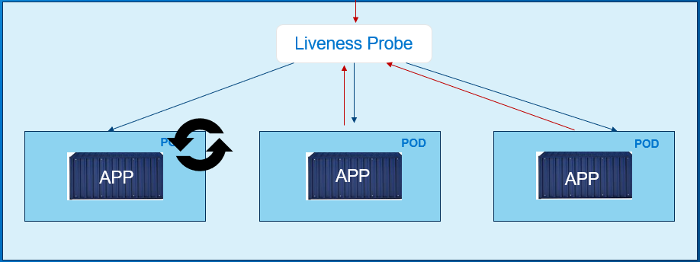
LIVENESS PROBE

Slide 16
LIVENESS PROBE

